Slide 1
Careers in Water

Slide 2
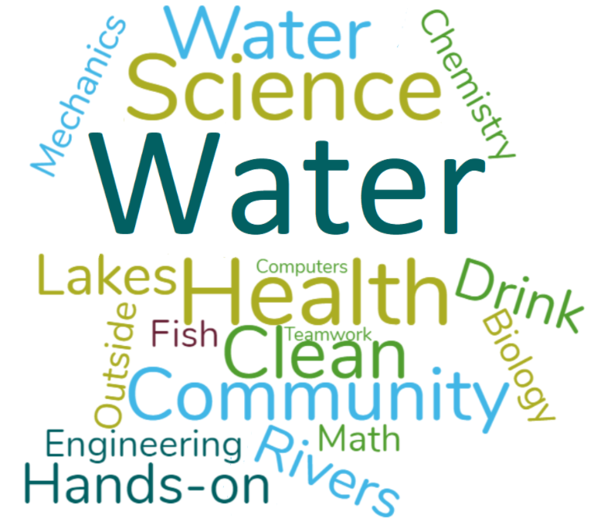
Careers in Water
Water utilities are responsible for protecting the health and safety of Vermont’s communities and environment.
Like many industries in Vermont, water utilities are facing a worker shortage. Many operations specialists at drinking water and wastewater treatment plants across the state are approaching retirement age, so there will be many jobs available in the next few years.
Water resources is a good field for you if you like to work with your hands, if you like science, if you want to contribute to your community, and if you don’t mind getting dirty.
Image source: https://vtruralwater.org/education/

Slide 3
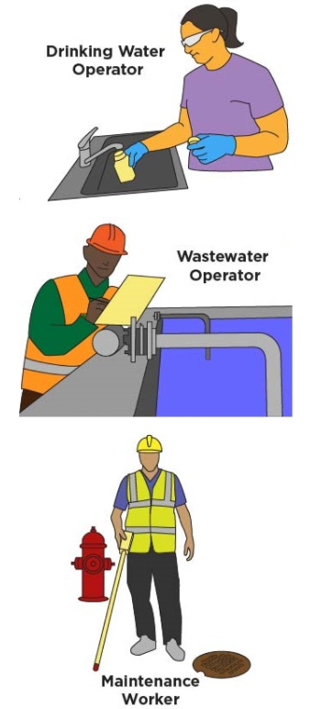
Explore Career Paths in Water
Drinking Water Operators perform skilled tasks in the construction, maintenance, and repair of drinking water system facilities. Operators of drinking water facilities provide safe drinking water to the public.
Wastewater Operators ensure that clean, treated water is released back into the state’s rivers, lakes, and groundwater.
Maintenance Workers install, maintain, and repair water services, valves, mains, meters, and hydrants; operate heavy equipment used in water service work; and perform a variety of skilled maintenance trades work.
Water Engineers deal with the provision of clean water, disposal of wastewater and sewage, and the prevention of flood damage. Their job involves repairing, maintaining and building structures that control water resources.
Want to Learn More? Check out: https://www.ngwa.org/advance-your-career/groundwater-industry-careers
Image Source: https://vtruralwater.org/education/

Slide 4
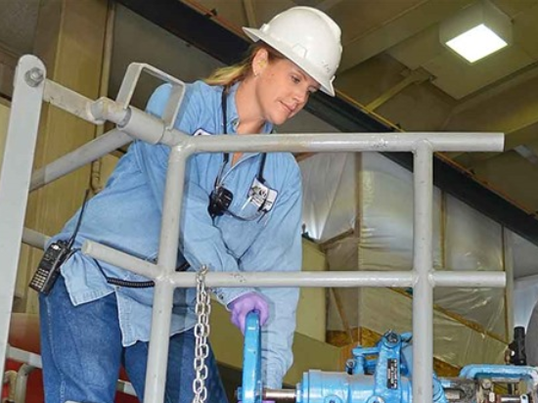
Drinking Water Operator
Knowledge of:
Operation and maintenance of water treatment plants
mechanical, electrical, and hydraulic principles
Principles and practices of standardized water quality tests
State and federal regulations governing the operation of a water treatment plant
Uses and principles of computerized electronic equipment in the collection, storage and interpretation of operational data, and
Inventory control of water treatment chemicals, fuel and supplies
Skill in:
Operating water treatment system equipment including automatic control devices and plant equipment
Maintaining safe and reliable water supply to customers
Servicing, repairing and calibrating plant equipment.
Ability to:
Recognize unusual, inefficient or dangerous operating conditions and take action
Accurately read, interpret and record data from gauges, meters and a SCADA system, and learn advanced SCADA system techniques
Read and interpret schematic drawings showing plant piping, alarms, mechanical, electrical controls, valves, and related instrumentation,
compile, evaluate and analyze operational data and information and recommend or take appropriate actions.
http://www.cawaterjobs.org/career/wastewater-treatment/
Source: https://www.workforwater.org/careers-in-water/drinking-water-treatment-operator/

Slide 5
Wastewater Treatment Operator
Knowledge of:
Operation, maintenance and cleaning of primary and secondary wastewater treatment equipment and facilities, wastewater treatment principles, safety rules, first aid, chemical handling, wastewater sampling and process control tests
Skill in:
Operating wastewater treatment plant equipment, including automatic control devices performing routine maintenance and making operating adjustments to wastewater treatment equipment
Cleaning and painting facilities and equipment
Ability to:
Instruct and direct lower level operators
Accurately read and record data from gauges and meters
Maintain plant equipment in connection with the operation of the wastewater treatment plant
Ensure water contamination is removed during the wastewater treatment process, through testing samples, cleaning tanks and other machinery, and keeping the process up-to-date on safety guidelines
http://www.cawaterjobs.org/career/wastewater-treatment/
Sources:
http://www.cawaterjobs.org/career/wastewater-treatment/
https://www.environmentalscience.org/career/wastewater-treatment-operator

Slide 6
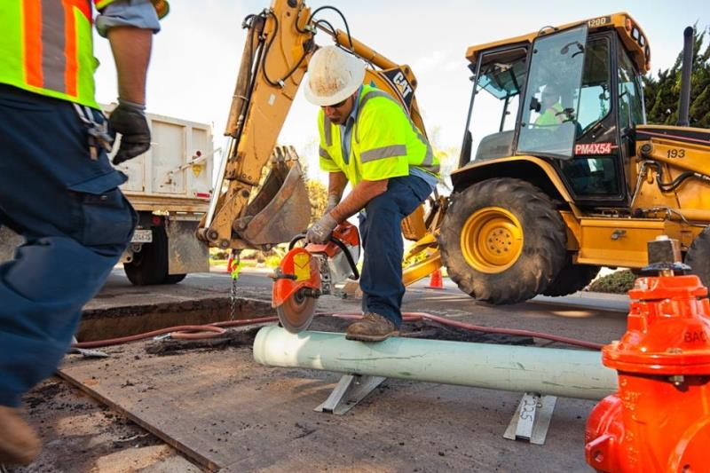
Water Maintenance Worker
Knowledge of:
Uses and purposes of common construction and maintenance tools and equipment,
Basic equipment operation, maintenance, and repair principles and practices,
Water distribution facilities including mains, meters, hydrants and valves,
Principles and methods of pipe laying, fitting, welding and concrete work.
Ability to:
Perform entry level unskilled/skilled responsible water system maintenance duties,
Learn to repair, install, and maintain water mains, services, hydrants and meters and valves,
Maintain basic accurate records of work performed,
Learn to lay and fit pipe; mix, pour and finish cement;
install valves and meters,
Learn to operate power-driven equipment, and welder used in water service work,
Learn to read water meters and turn-on and off service,
Learn to read and interpret plans, drawings, maps, and specifications,
Observe proper safety precautions, and
Operate a vehicle observing legal and defensive driving practices.
http://www.vwd.org/departments/operations-and-maintenance

Slide 7
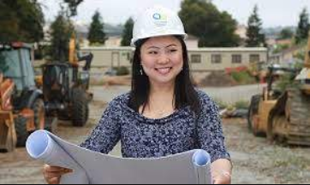
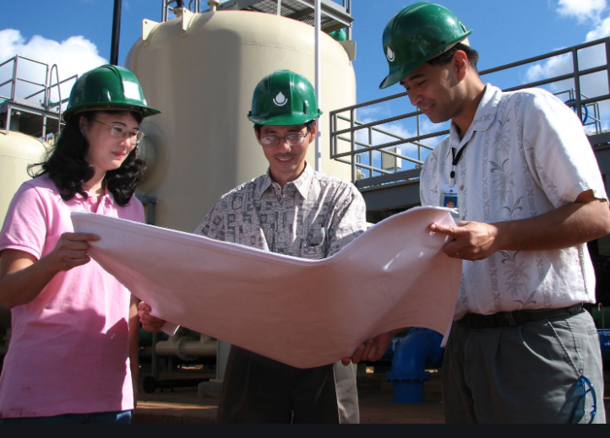
Water Engineer
Knowledge of:
Uses and purposes of common construction and maintenance tools and equipment,
Basic equipment operation, maintenance, and repair principles and practices for use in wastewater processing to ensure compliance with government standards
Water supply systems, runoff collection networks, water and wastewater treatment plants, or wastewater collection systems.
Efficiency of water delivery structures, such as dams, tainter gates, canals, pipes, penstocks, or cofferdams.
Ability to:
design sewer improvement plans or flood defense programs, and associated structures, such as pumping stations, pipework and earthwork
keep up to date with environmental matters; being aware of policy and developments
present technical data or project results; both technical and non-technical
keep track of the progress of projects from beginning to end - from feasibility, to design through to construction and handover (or handling just one section of a large project)
control budgets at the project level
use computer simulations to analyze, for example, potential dam failure
monitor flood levels at times of high risk
https://baywork.org/career-path/engineer/
https://www.boardofwatersupply.com/jobs/how-we-work

Slide 8
Check out the activity and video guide for opportunities to deepen your learning!
These educational materials were created through a partnership between Vermont Works for Women and the Vermont Rural Water Association to support water education for Vermont’s students.
Vermont Rural Water Association
Clean Water for Vermont Communities.

