Slide 1
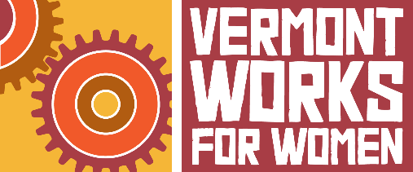
Drinking Water

Slide 2
What is drinking water?
Drinking water: water that is potable (safely drinkable or usable in food preparation)
What is not drinkable water?
Does potable/drinking water occur naturally?
Think about the last time you drank water…
Do you know where it came from?
How did you know it was okay to drink?

Slide 3
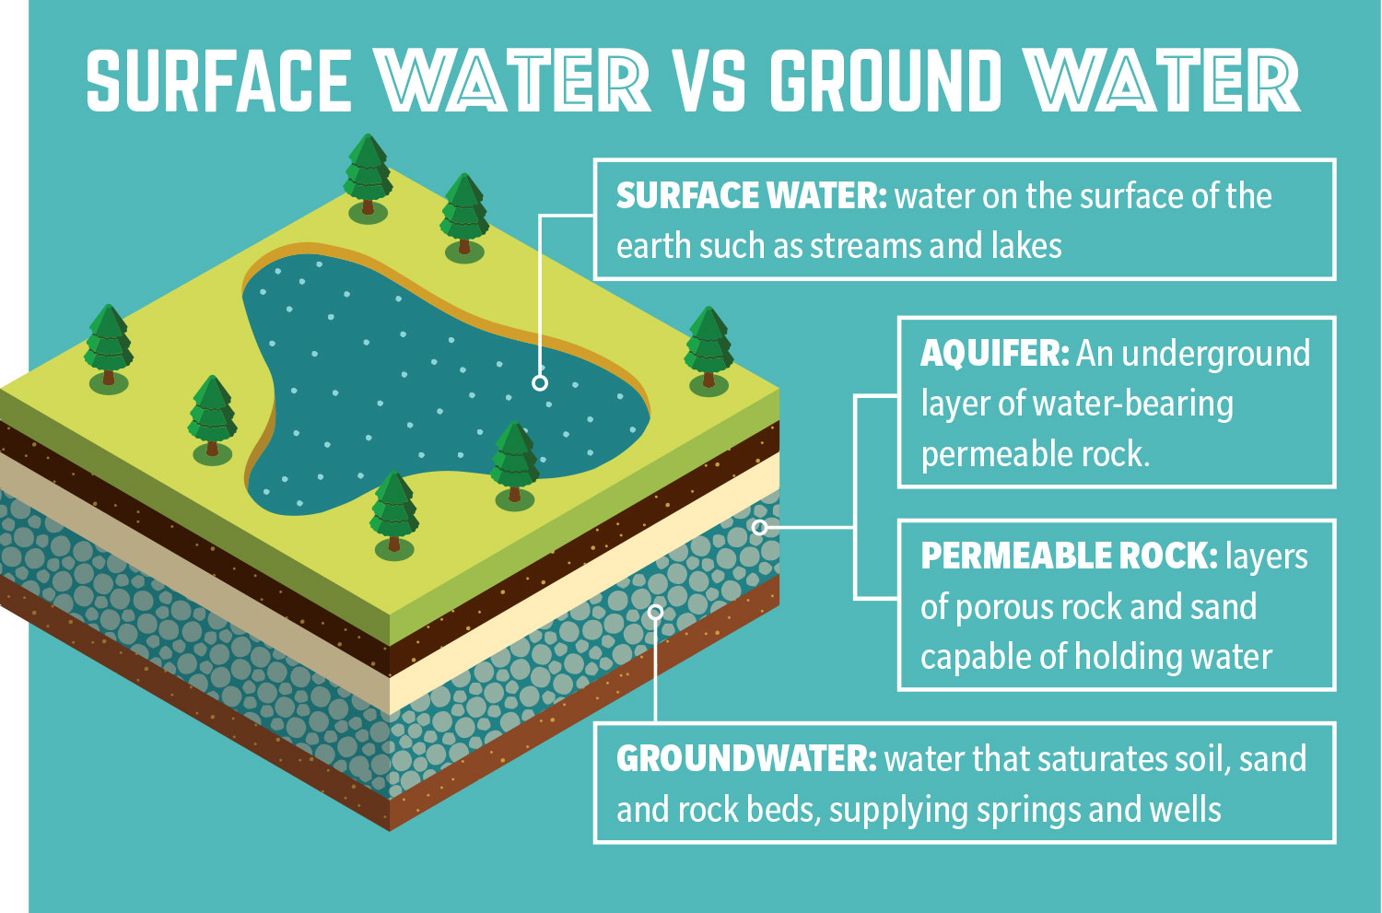
Water Sources
Where in the earth does drinking water come from?
All water that you drink is either
SURFACE WATER
or
GROUNDWATER
Surface water always requires treatment.
Groundwater may or may not require treatment, depending on the aquifer.
Image: https://communityimpact.com/city-county/2019/09/11/water-rates-in-turmoil-amid-disputes-over-groundwater/

Slide 4
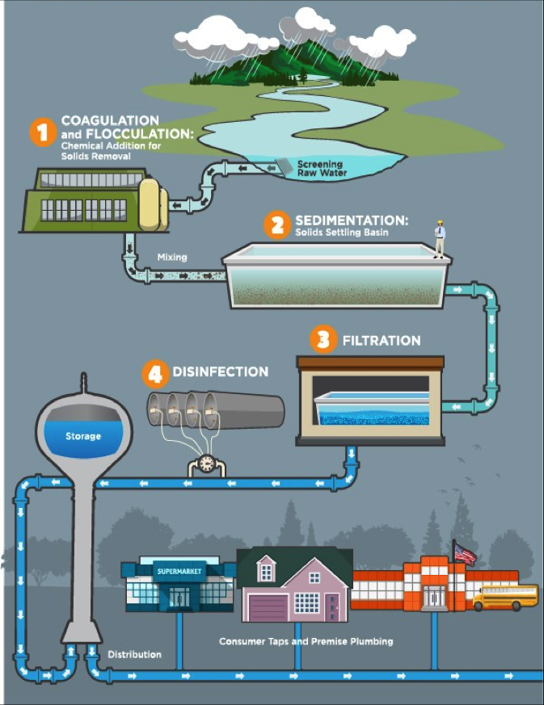
Water Treatment
How does water become drinkable?
Water goes through a series of steps to remove contaminants and kill microorganisms. Sometimes chlorine or fluoride will be added.
Potential contaminants include bacteria, nitrates, lead, arsenic, and uranium.
Image: https://waterandhealth.org/safe-drinking-water/finished-drinking-water-treatment-fundamentals/

Slide 5
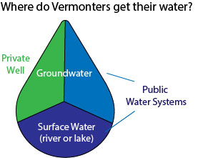
Two types of water systems: Public and Private
Who owns and controls the water?
Public Water System
Provides water to a large group of people (i.e. municipality, school, or neighborhood)
Private Water System
Owned by a small group of people or an individual (i.e. private wells)

Slide 6
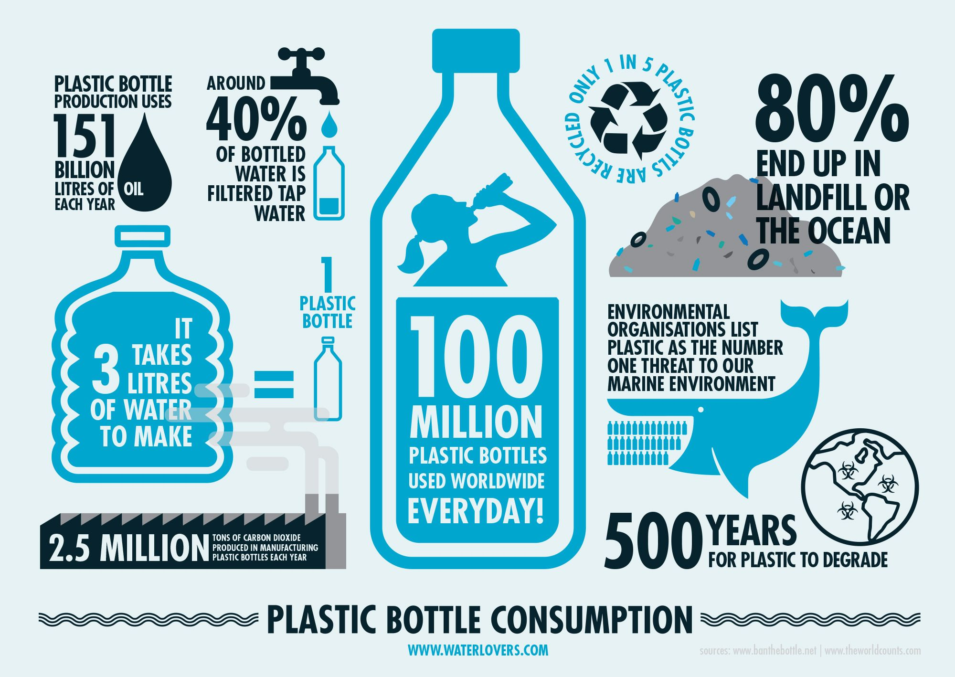
What about bottled water?
Bottled water is water that companies buy, bottle, and re-sell for profit.
The water may come from the tap or from surface or groundwater.
Image from: www.waterlovers.com

Slide 7
Check out the activity and video guide for opportunities to deepen your learning!
These educational materials were created through a partnership between Vermont Works for Women and the Vermont Rural Water Association to support water education for Vermont’s students.
Vermont Rural Water Association
Clean Water for Vermont Communities.

