Slide 1
Stormwater and Wastewater

Slide 2
What is Stormwater?
Precipitation (rain, snow, etc.) that falls on land will either be absorbed by plants, soak into the soil, evaporate, or become stormwater runoff.
Image: https://dec.vermont.gov/watershed/stormwater

Slide 3
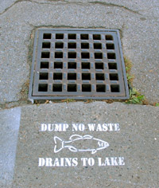
Stormwater Runoff
Paved surfaces like roads, parking lots and roofs do not allow water to soak into the ground. Instead, water flows through stormdrains to waterways or retention ponds
Runoff can pick up pollutants and carry them to rivers and lakes, harming aquatic ecosystems and polluting drinking water.
What pollutants can runoff carry?
What are some ways we can reduce stormwater runoff?
https://www.lcbp.org/water-environment/water-quality/stormwater/

Slide 4
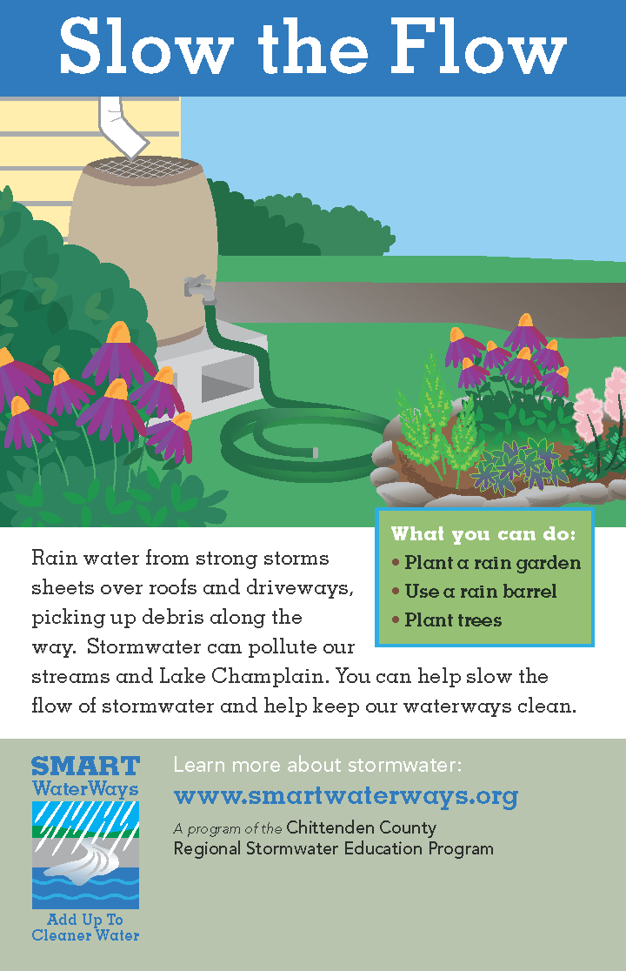
Manage Stormwater
Keep stormwater drains clear of leaves and litter
Pick up pet waste
Repair leaks and drips from your vehicle
Don’t pour anything into storm drains, including paints, solvents, cleaners, etc.
Minimize the use of herbicides and pesticides
Use a rain barrel and plant a rain garden!
https://stormwater.wef.org/2015/05/stormy-awards-elevate-new-england-stormwater-efforts/rsep_spring_2014_print_ads_page_2/

Slide 5
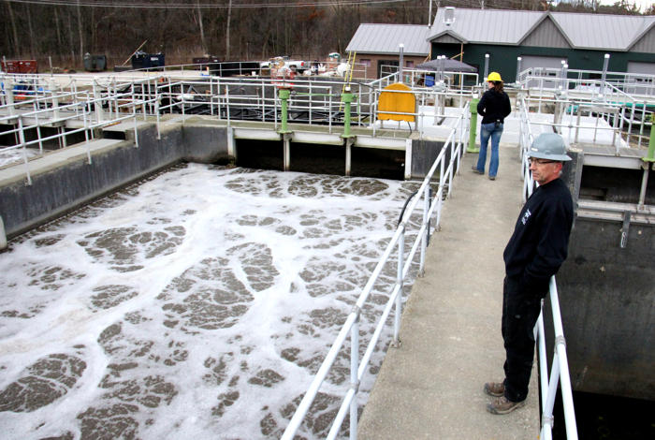
What is Wastewater?
Wastewater is used water that goes down the drain. It may contain human waste, food scraps, oils, soaps, and chemicals.
In homes, wastewater comes from sinks, showers, bathtubs, toilets, washing machines, and dishwashers
Businesses like food production and manufacturing also release wastewater
https://www.youtube.com/watch?v=Y3-P_Lm36K8

Slide 6
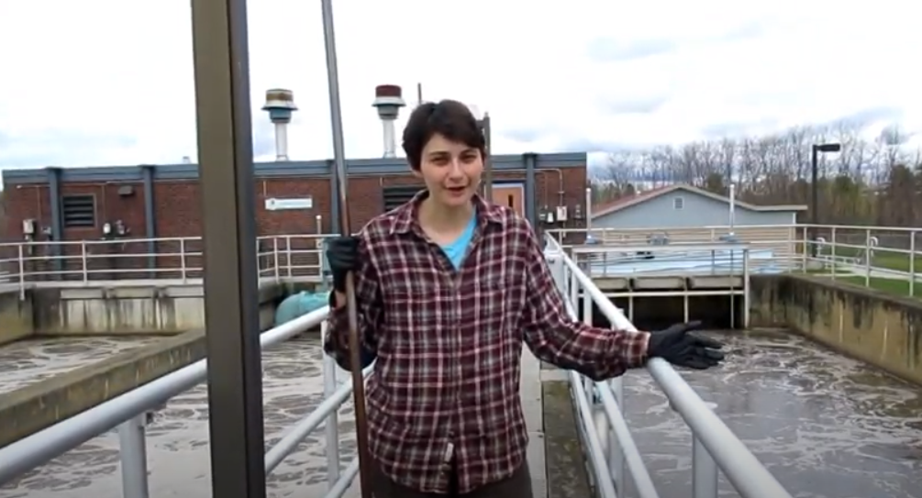
Wastewater Treatment
Steps:
Remove solids
Remove pollutants and nutrients
Disinfect
Return water to river, lake, or groundwater
Watch the wastewater treatment process in South Burlington https://www.youtube.com/watch?v=Y3-P_Lm36K8

Slide 8
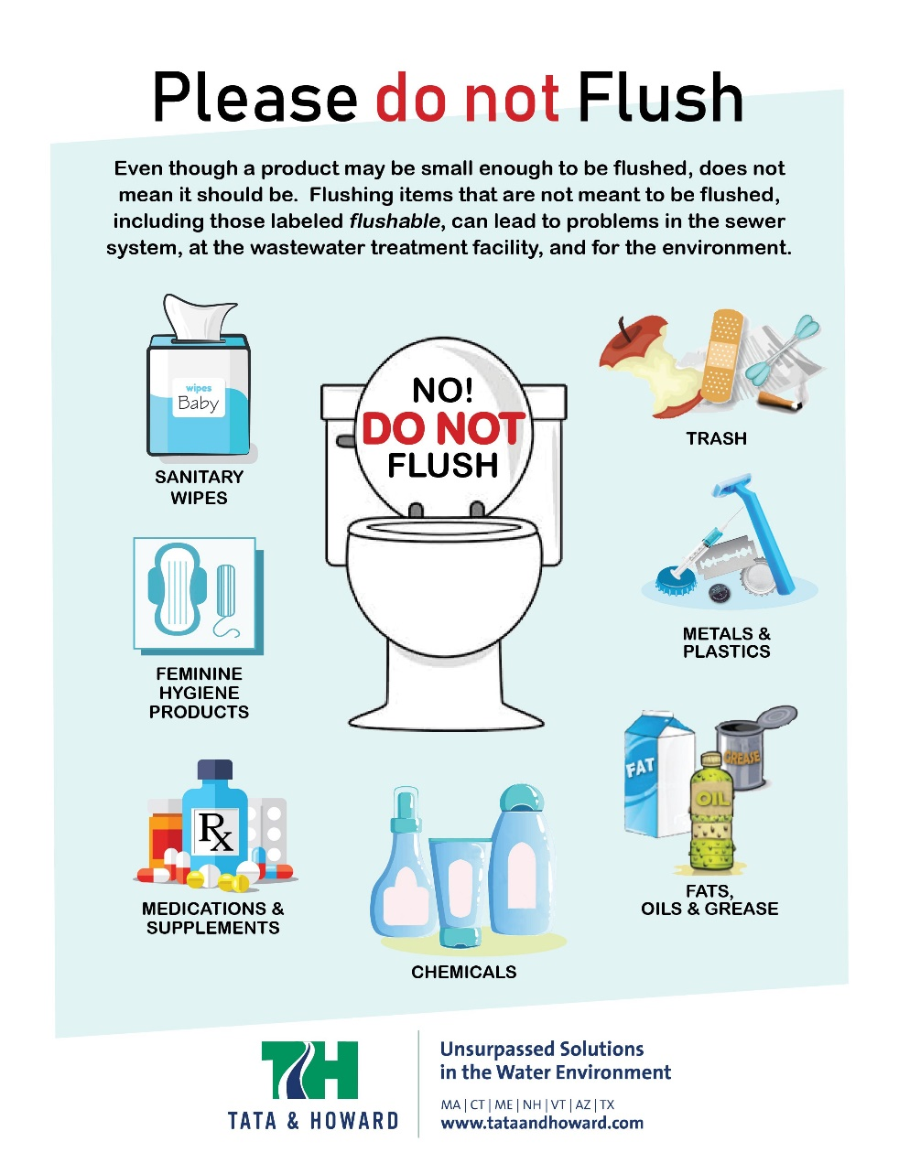
Never put these down the sink or toilet:
Fats, oils or grease
Food scraps
Trash
Menstrual products or diapers
Paper towels or tissues
Wipes, even ones labeled Flushable!
https://tataandhoward.com/please-do-not-flush/

Slide 9
Check out the activity and video guide for opportunities to deepen your learning!
These educational materials were created through a partnership between Vermont Works for Women and the Vermont Rural Water Association to support water education for Vermont’s students.
Vermont Rural Water Association
Clean Water for Vermont Communities.

